Slide 1
Trivia

Slide 2
What colour is the Red Sea? A. Red B. Yellow C. Blue D. Pink
Question 1

Slide 3
Question 2
Ducula is a genus of
A. duck
B. vampire bat
C. pigeon
D. fairy

Slide 4
Question 3
Who won the Wimbledon women’s singles title in 2005?
Freddie Mercury
Venus Williams
Mother Earth
Bruno Mars

Slide 5
An armadillo is A. A fleet of Spanish war ships B. A spray for protecting leather furniture C. A scouring pad for cleaning ovens D. A leathery-skinned animal found in America
Question 4

Slide 6
Question 5
Comet was most famously
A. A reindeer
B. An albatross
C. A Jersey cow
D. A slug

Slide 7
Camels can drink up to how much in one go A. 2 L B. 20 L C. 200 L D. 2000 L
Question 6

Slide 8
A kilojoule is a unit of A. Fat B. Sugar C. Energy D. Weight
Question 7

Slide 9
Question 8
The galaxy we live in is called
The Mars Bar
The Milky Way
The Picnic
The Crunchie

Slide 10
Question 9
A giant panda’s diet mostly consists of
A. algae
B. bamboo
C. Chinese children
D. ducks

Slide 11
Question 10
An exoplanet is
A planet that isn’t in the solar system
Something that used to be a planet but isn’t now
A planet situated near the exit
A planet that has been exorcised (i.e. had an evil spirit cast out of it)

Slide 12
Question 11
Katniss Everdeen is the main character in which movie?
A. Frozen
B. The Hunger Games
C. Jaws
D. Mary Poppins

Slide 13
Question 12
How many people in the boat in a rowing 8?
A. 6
B. 7
C. 8
D. 9

Slide 14
First name of the famous Italian artist Buonarotti A. Giuseppi B. Michaelangelo C. Donatelli D. Steve
Question 13

Slide 15
The shortest verse in the bible is A. Jesus wept B. Go in peace C. I’ll be back D. Oh my God
Question 14

Slide 16
Question 15
A light year is
A year when the sun shines a lot
1000 normal years
The same as a normal year but with fewer calories
About 10 trillion kilometres

Slide 17
Question 16
A worm hole is
A hole made by a worm
A tube connecting two positrons
The fundamental particle in string theory
A worm’s antiparticle

Slide 18
Which is correct? A. The yolk of an egg are white B. The yolk of an egg is white C. Neither of the above D. Both A and B
Question 17

Slide 19
Question 18
Circling Uranus is something called ‘*uck’. The missing letter is
D
P
Y
None of these

Slide 20
In ancient Rome, the architectural feature called a vomitorium was A. A hospital B. The entranceway to an amphitheatre C. A mathematics classroom D. A room for regurgitating food during meals
Question 19

Slide 21
Question 20
Pumbaa in Lion King suggests that the stars are
Fireflies that got stuck up in that big bluish-black thing
Balls of gas burning billions of miles away
Candles carried by angels
Pin pricks in the roof of the world letting in light from above

Slide 22
Which of these held patents for improvements to toilets? A. George Washington B. Genghis Khan C. Thomas Crapper D. Heath Bogroll
Question 21

Slide 23
The longest a chicken has lived without its head is: A. 2 minutes B. 2 hours C. 2 days D. 2 years
Question 22

Slide 24
Question 23
Neutron stars are sometimes produced in supernova explosions. One teaspoonful of the core of a neutron star would have a mass of about
0.2 g
20 kg
20 000 tonnes
1 000 000 000 tonnes

Slide 25
According to the biblical book of Genesis, mankind became sinful because Adam and Eve ate A. An apple B. A pear C. A potato D. An unspecified fruit
Question 24

Slide 26
The famous person who married Eva Braun, then promptly shot himself was: A. Friedrich Braun B. Adolf Hitler C. Benito Mussolini D. Nostradamus
Question 25

Slide 27
Question 26
‘My very easy memory jingle just seems useless now.’ This is a way to remember:
The order of the planets
The different types of stars
The last 8 presidents of Kazakhstan
The first 8 decimal places of pi

Slide 28
Which came first, the chicken or the egg? A. The chicken B. The egg C. They both came at the same time D. They’ve both been around for ever
Question 27

Slide 29
Question 28
The stress-energy tensor features most prominently in
‘Vocal Techniques’ by Placido Domingo
‘An Inconvenient Truth’ by Al Gore
‘The Theory of General Relativity’ by Albert Einstein
‘The Manual of Body Building’ by Charles Atlas

Slide 30
The square root of 21547 is A. 3 B. -3 C. 6.2 D. Who cares?
Question 29

Slide 31
Question 30
For saying that the Earth goes round the Sun rather than vice versa, Giordano Bruno was:
Made a professor at Oxford University
Poked in the eye with a sharp stick
Burnt at the stake
Fined $250

Slide 32
Wallace’s dog is called: A. Fido B. Vomit C. Gromit D. Grovel
Question 31

Slide 33
Florence Nightingale, a famous English nurse in the nineteenth century, is know as: A. The lady with the limp B. The lady with the lamp C. The lady with the lump D. The lady with leprosy
Question 32

Slide 34
Question 33
If there was air all the way from here to the Sun, on Earth, the Sun would seem
Quieter than a mouse
As noisy as a busy street
As noisy as a loud rock concert
Loud enough to instantly rupture your eardrums

Slide 35
DNA is best known to stand for: A. Dribbly-nosed antelope B. Deoxyribonucleic acid C. National Dyslexics Association D. Don’t know anything
Question 34

Slide 36
What animals are the Canary Islands named after? A. Dogs B. Cats C. Canaries D. Dragons
Question 35

Slide 37
Which of the following is the most healthy BMI (body mass index)? A. 20 B. 30 C. 45 D. 170 Helpful hint: BMI = mass ÷ height² (mass in kg, height in m)
Question 36

Slide 38
Which has the largest brain in comparison to its body weight? A. dolphin B. human C. fruit bat D. ant
Question 37

Slide 39
Complete this foursome of Jupiter’s largest moons: Io, Europa, Ganymede . . . A. Satan B. Calisto C. Mephistopheles D. Beelzebub
Question 38

Slide 40
Lightning strikes the Earth on average: A. once per hour B. once per minute C. once per second D. 50 times per second
Question 39

Slide 41
Andy Warhol is famous for painting: A. soup D. babies B. dead animals C. potato salad
Question 40

Slide 42
Which country has the most tigers? A. India B. Bangladesh C. USA D. Brazil
Question 41

Slide 43
If the land area of the Earth were shared equally between all the people on Earth, each would get approximately: A. 200 m², B. 2 hectares, C. 2 km², D. 200 km²
Question 42

Slide 44
In which country dID Panama hats originate? A. Panama B. Ecuador C. Brazil D. Germany
Question 43

Slide 45
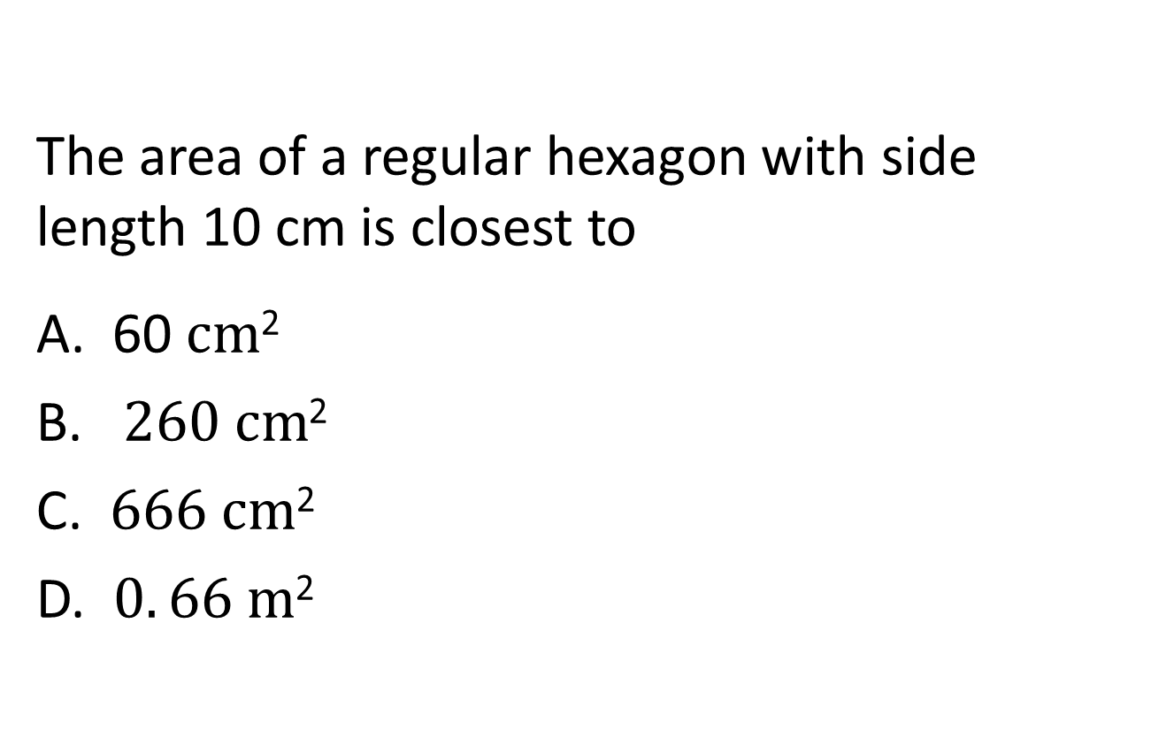
The area of a regular hexagon with side length 10 cm is closest to A. 60 $cm$² B. $260 cm$² C. $666 cm\text{2}$ D. $0. 66 m$²
Question 44

Slide 46
How many letters in Carrot? A. 2 B. 4 C. 6 D. 8
Question 45

Slide 47
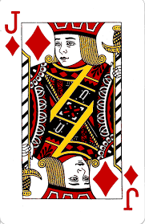
Question 46
This card is
A. The joker
B. The jack of diamonds
C. The joker of diamonds
D. The jolly roger

Slide 48
Question 47
Neutrinos from the sun pass right through your body at about the speed of light.
How often does this happen.
Once every 20 years
10 times a day
50 times a second
1 000 000 000 000 times a second

Slide 49
The chemical formula for the carbohydrate sucrose (cane sugar) is A. C₁₂H₂₂O₁₁ B. H₂SO₄ C. CO₂ D. Mg₂SiO₄
Question 48

Slide 50
Which of the following countries does not border France? A. The Netherlands B. Germany C. Luxembourg D. Andorra
Question 49

Slide 51
111111111 x 111111111 = A. 111111111111111.111 B. 123456789123456789 C. 12345678987654321 D. 143724690688317556
Question 50

Slide 52
Question 51
Astronomer Tycho Brahe wore a nose made from silver and gold. He lost his real one in a sword duel fought over
the honour of his servant, Emily Sorenberg
damage done to his telescope
an argument about the time it takes Saturn to orbit the Earth
an argument about the validity of a mathematical formula

Slide 53
When a 747 is in flight, waste from the toilets is: A. Jettisoned and burns up on its way to the ground B. Only jettisoned when the plane is over water C. Kept and off-loaded at the next airport D. Recycled and fed to the passengers as aircraft meals
Question 52

Slide 54
Question 53
The Sun makes up closest to what percentage of the mass of the solar system
50%
90%
99%
100%

Slide 55
Question 54
‘Twinkle twinkle little . . . ., How I wonder why you dig’.
The missing word is:
star
pig
planet
dwarf
Note: it must rhyme.

Slide 56
Question 55
Hawking radiation that causes black holes to evaporate is named after:
Stephen Hawking
Julie Smith
Piggy Marshall
Sadie Arthropod-Mollusc

Slide 57
Question 56
Supanova is:
An explosion of a massive star that occurs when it runs out of fuel
A pop culture expo held annually in various Australian cities
Anything that’s new and really cool
A boil on the neck caused by streptococcal bacteria

Slide 58
Question 57
Which of the following is not a reindeer?
(according to the well-known Christmas song)
Rudolf
Blitzen
Comet
Asteroid

Slide 59
In which country are the Canadian Rockies? A. Canada B. Canadia C. USA D. America
Question 58

Slide 60
The active ingredient in panadol is A. paracetamol B. nurofen C. ibuprofen D. cocaine
Question 59

Slide 61
The closest star to Earth is A. Sirius B. Alpha Centauri C. Proxima Centauri D. None of these
Question 60

Slide 62
Question 61
Which number, when spelt, has its letters in alphabetical order?

Slide 63
Question 62
What is the smallest number that contains a P when spelt.

